Slide 1

Magnetic Properties
Dr. J. Venkatramani
219-B
venkatramani@iiitdm.ac.in

Slide 2
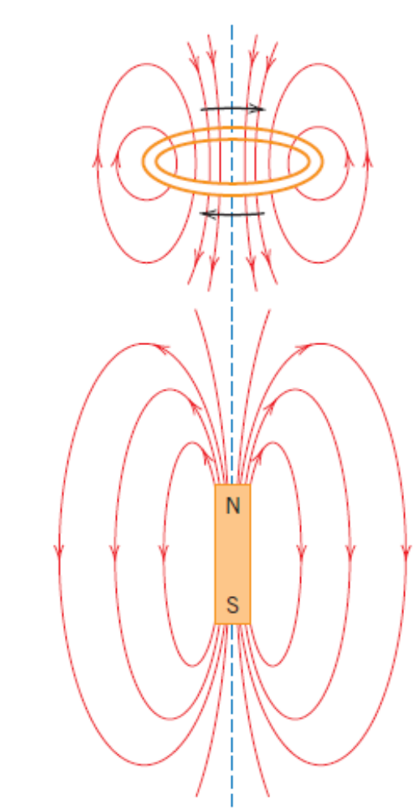
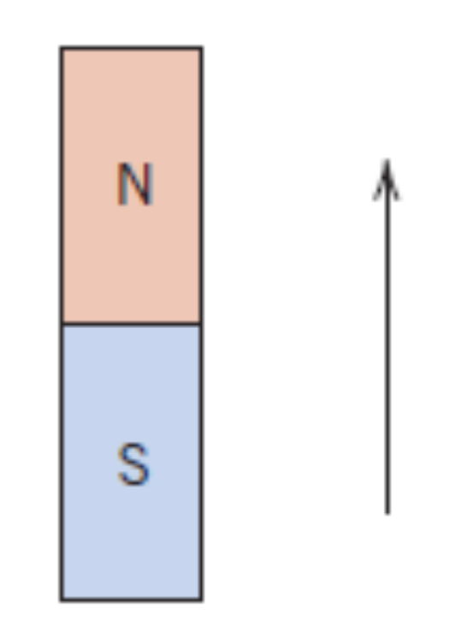
Magnetism
Magnetic field around a current carrying conductor and a bar magnet.
Magnetic dipole – analogous to electric dipole

Slide 3
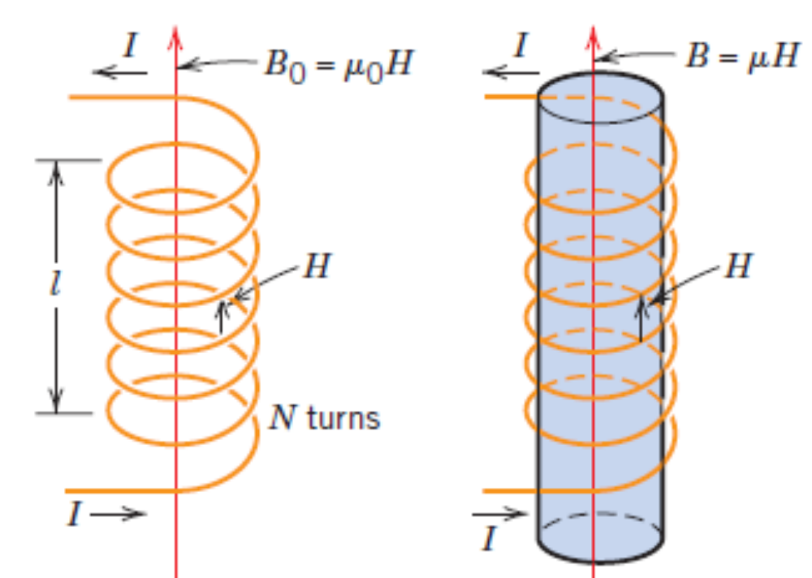
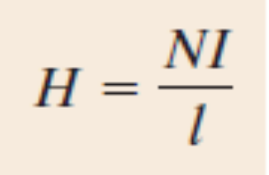
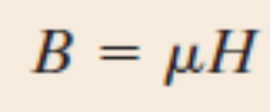
Terminology and Notation
H – Magnetic field strength B – Magnetic Induction or Magnetic flux density
N – Number of turns in a coil of length l, carrying current I.
Magnetic flux density in any medium is given by
Where, μ is permeability of the medium
In vacuum μ = μ₀ = 4π X 10^{–7} Wb/(A – m)

Slide 4
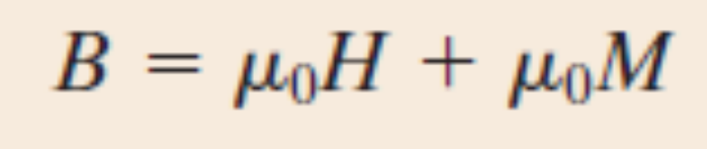
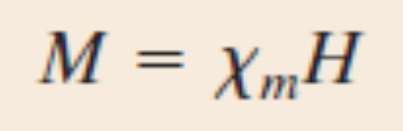
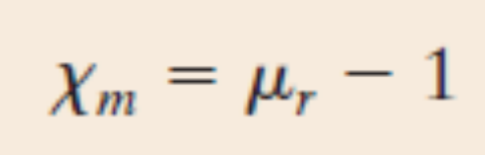
Magnetization (Analogous to Polarization)
M – Magnetization
χ_{m} – Magnetic susceptibility

Slide 5
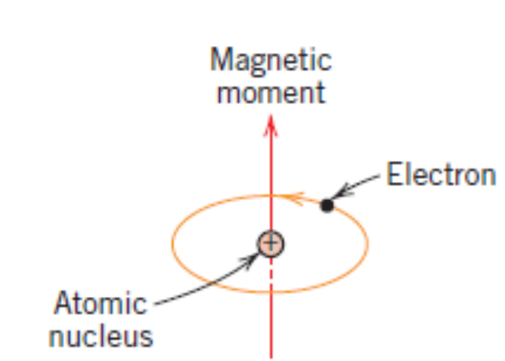
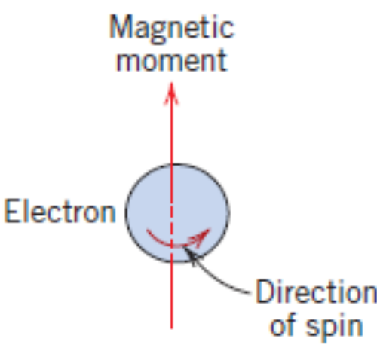
Origins…
Two sources:
Orbital motion around the nucleus
Due to spin
Bohr Magneton, μ_{B} = 9.27 X 10^{–24} A–m². Spin magnetic moment of an electron is ±μ_{B}.
The orbital magnetic moment contribution is equal to m_{l} μ_{B}, where m_{l} is the magnetic quantum number.

Slide 6
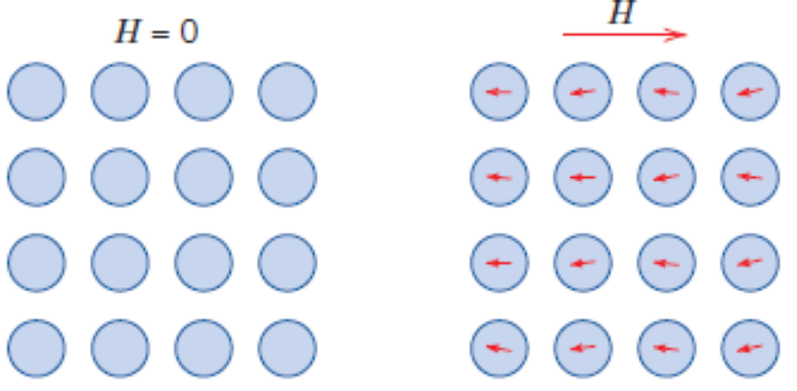
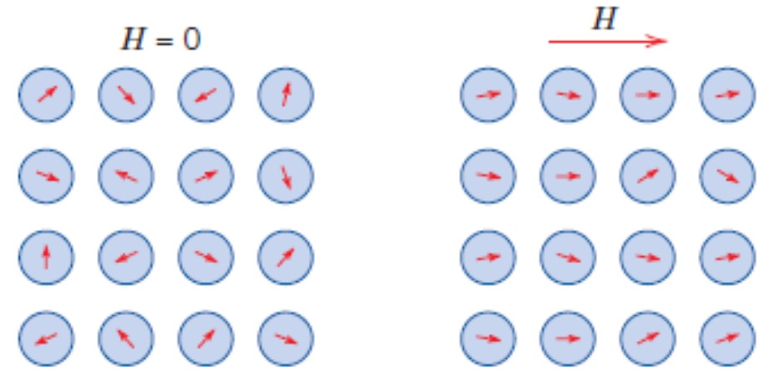
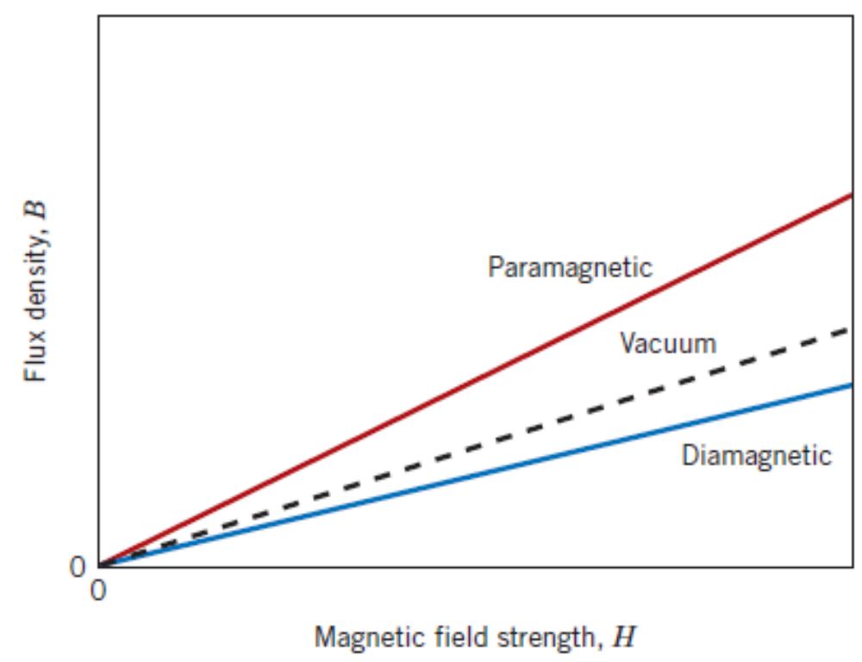
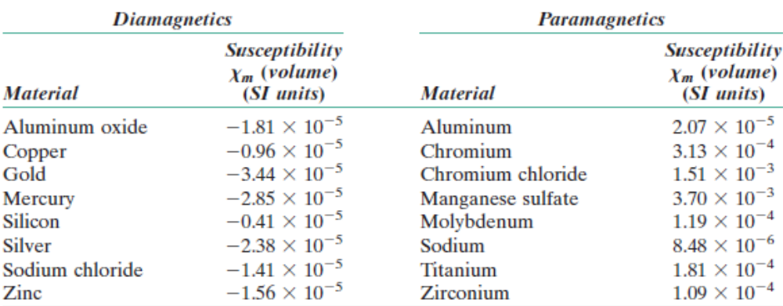
Diamagnetism and Paramagnetism
Diamagnetism
Paramagnetism

Slide 7
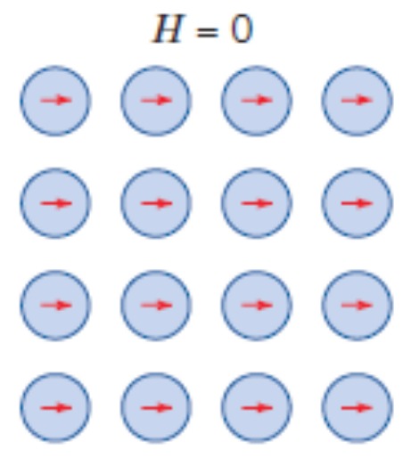
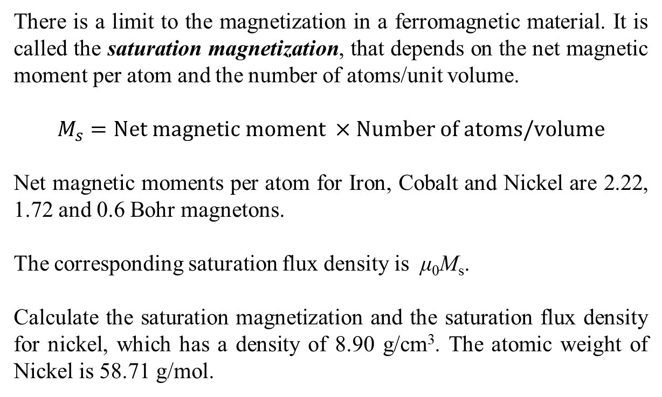
Ferromagnetism
Existence of aligned dipoles even in the absence of external field.
There is a limit to the magnetization in a ferromagnetic material. It is called the saturation magnetization, that depends on the net magnetic moment per atom and the number of atoms/unit volume.
$$M_{s}=Net magnetic moment ×Number of atoms/volume$$
Net magnetic moments per atom for Iron, Cobalt and Nickel are 2.22, 1.72 and 0.6 Bohr magnetons.
The corresponding saturation flux density is μ₀M_{s}.
Calculate the saturation magnetization and the saturation flux density for nickel, which has a density of 8.90 g/cm³. The atomic weight of Nickel is 58.71 g/mol.

Slide 8
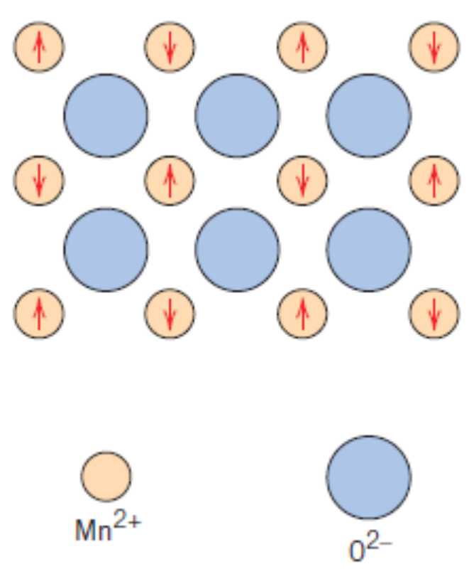
Antiferromagnetism
Example: MnO
O^{2–} ion does not have any net magnetic moment.
Mn²⁺ do have net magnetic moments but, all of them cancel out each other and as a result the solid as a whole does not have any net magnetic moment.

Slide 9
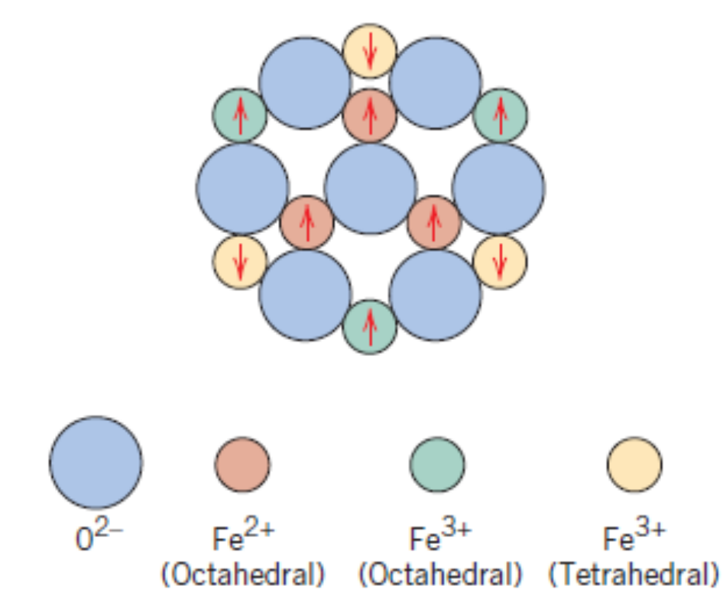
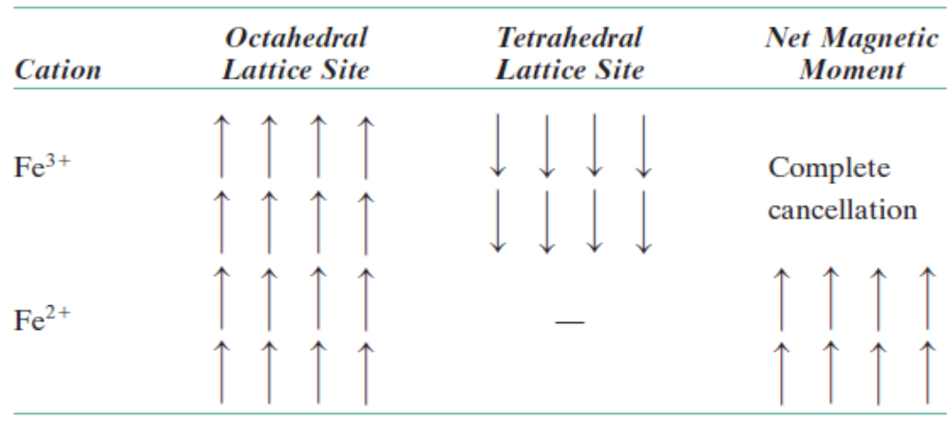
Ferrimagnetism
Permanent magnetism in ceramics. Example: Magnetite or lodestone.

Slide 10
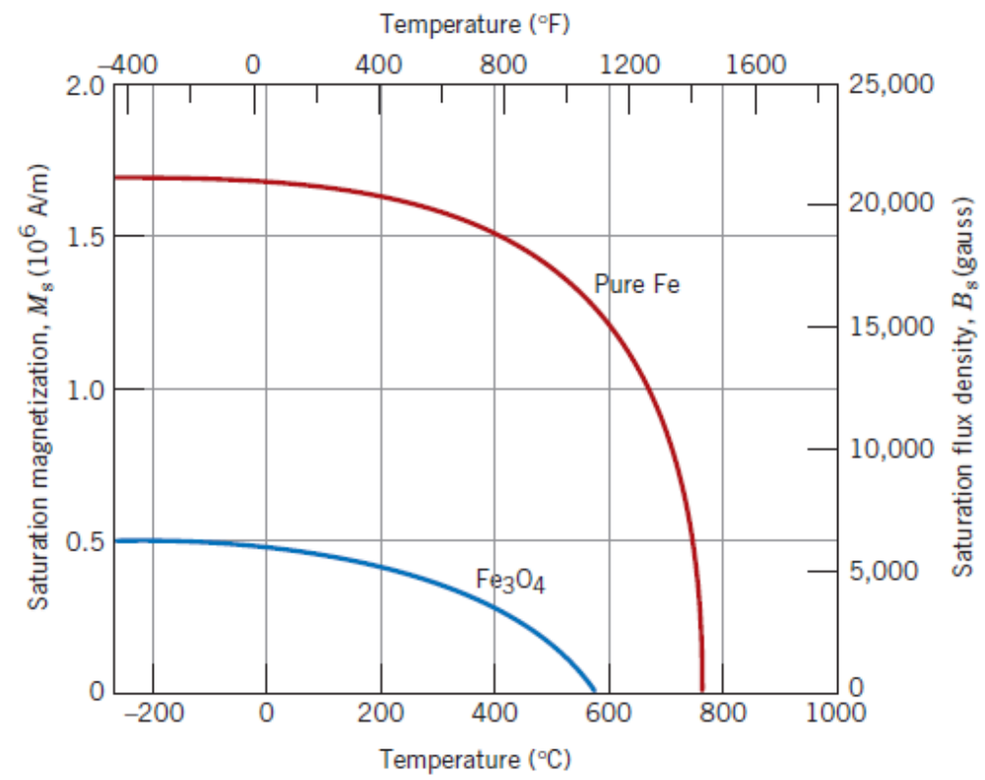
Influence of Temperature

Slide 11
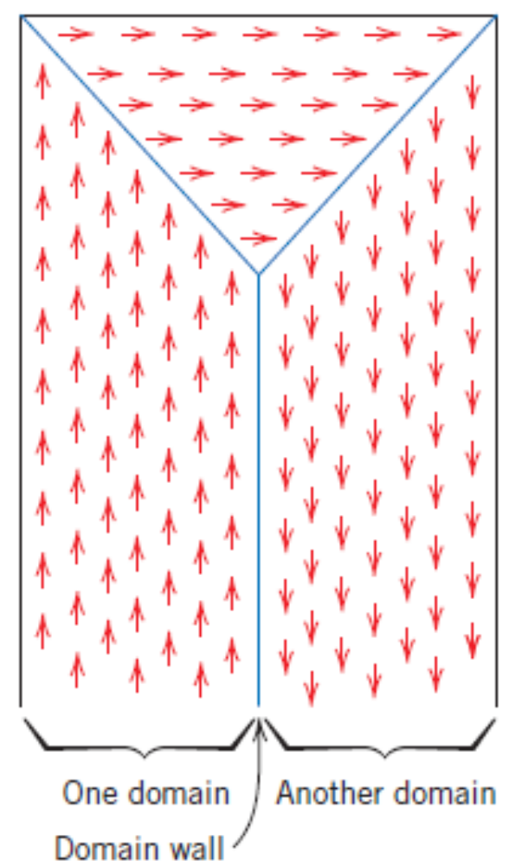
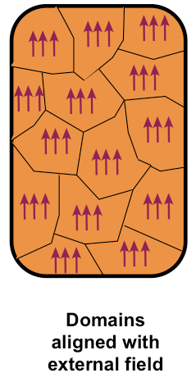
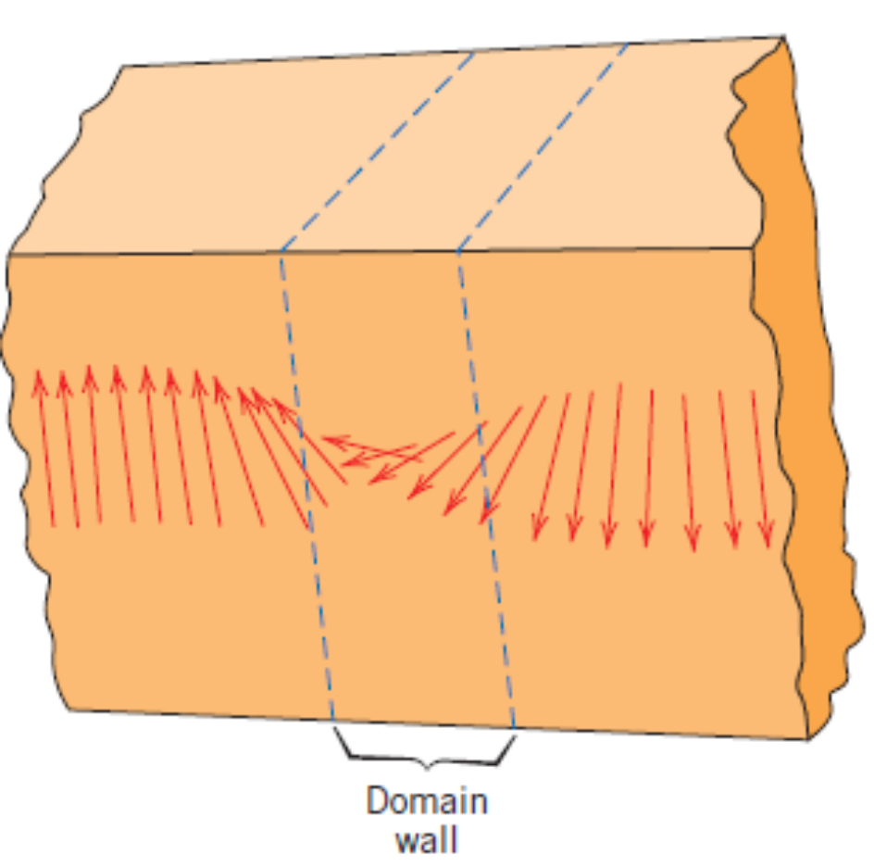
Domains and Hysteresis

Slide 12
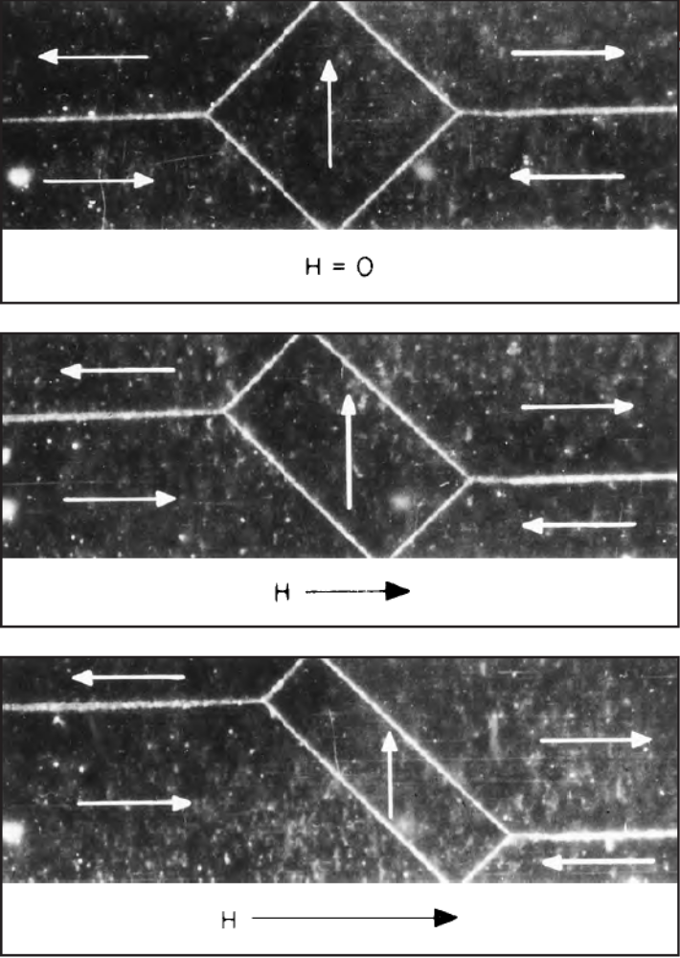
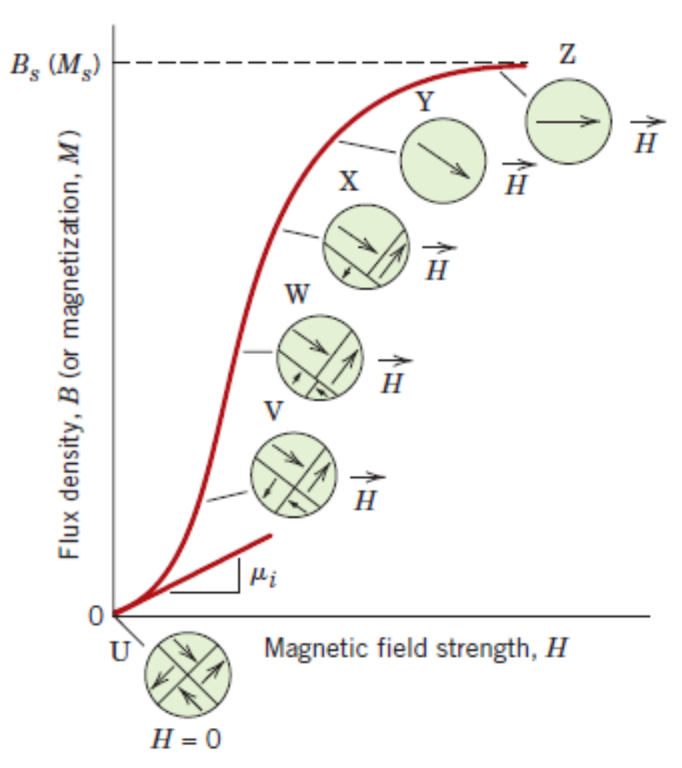
Domains and Hysteresis
Permanent magnetism in ceramics. Example: Magnetite or lodestone.

Slide 13
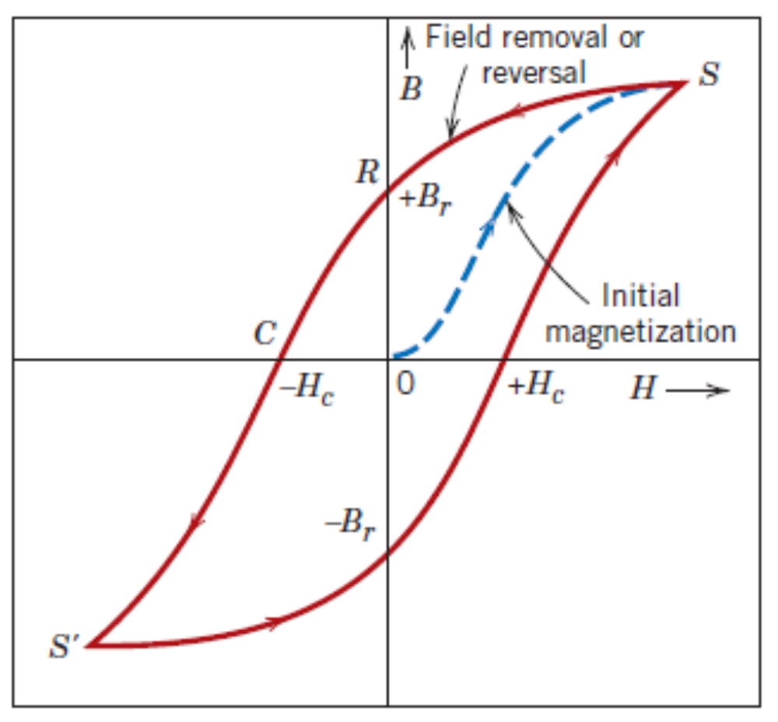
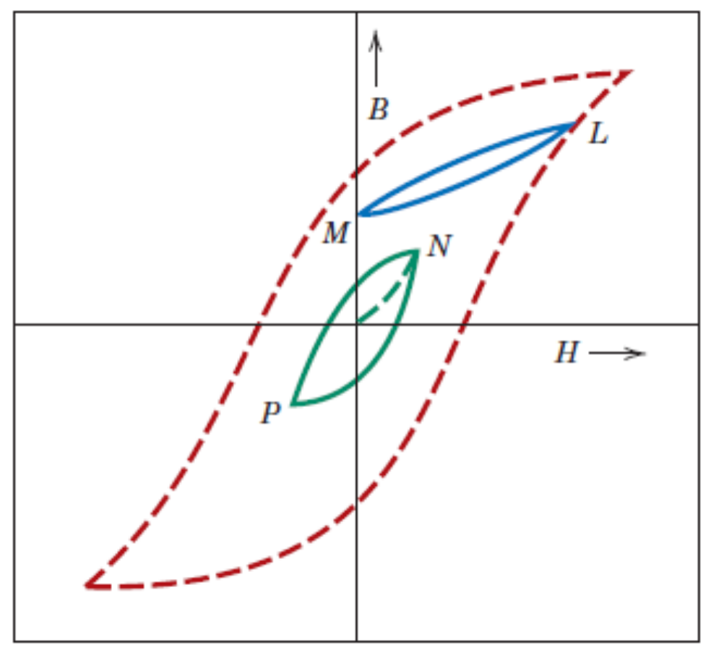
Domains and Hysteresis
H_{c} – Coercive field or coercive force

Slide 14
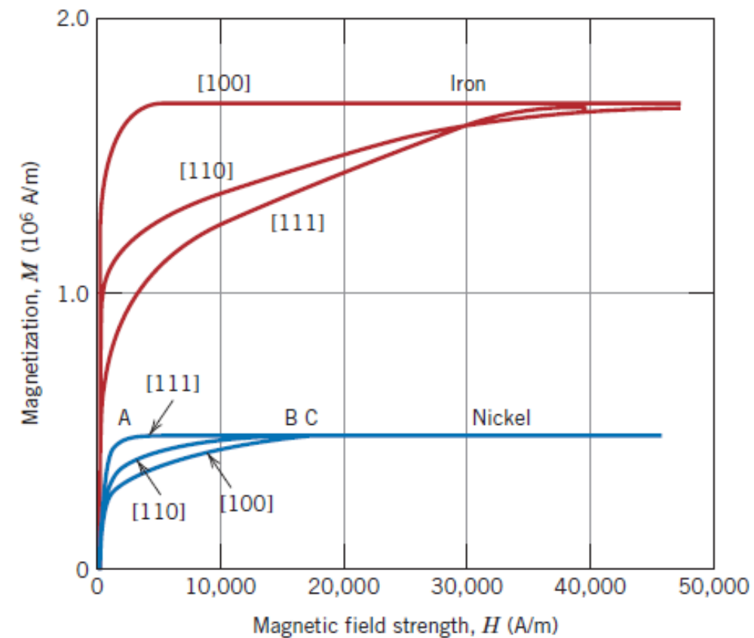
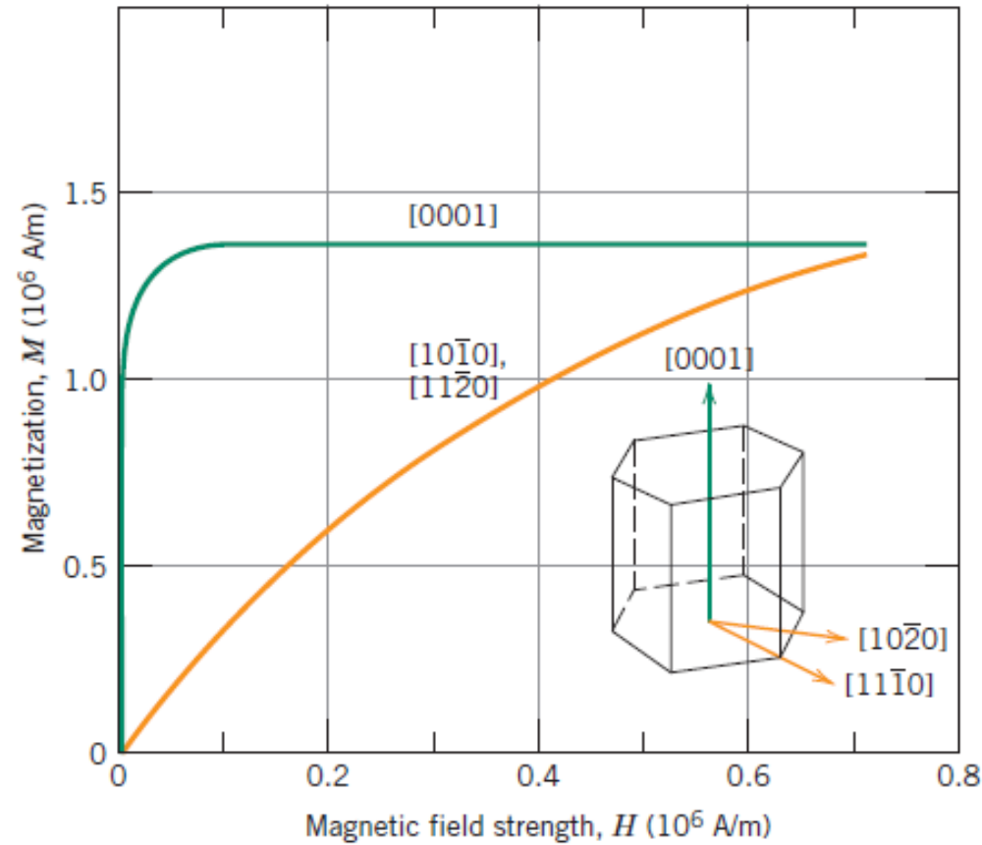
Magnetic Anisotropy
Factors affecting hysteresis behaviour of a magnetic material:
Single crystal or polycrystalline
Preferred orientation of grains in a polycrystalline material
Pores and second phase particles
Temperature, state of stress
Cobalt

Slide 15
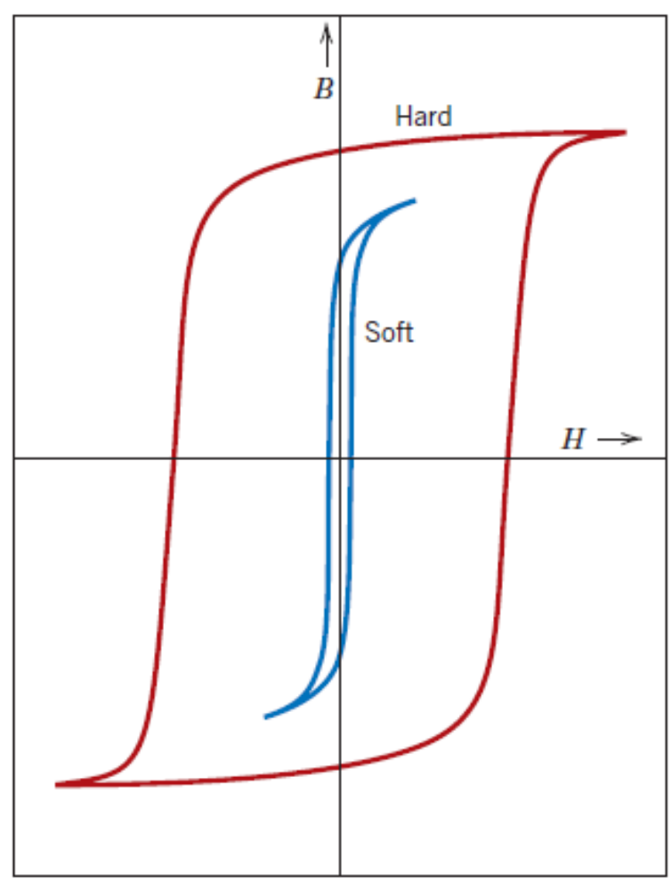
Soft and Hard Magnetic Materials
Soft magnetic materials are the ones which involve lesser energy loss during magnetization–demagnetization cycle.
They can be used in applications involving alternating magnetic fields.
Structural defects tend to increase the coercivity.
Higher electrical resistivity are desirable in order to avoid any eddy currents induced by alternating magnetic fields.

Slide 16
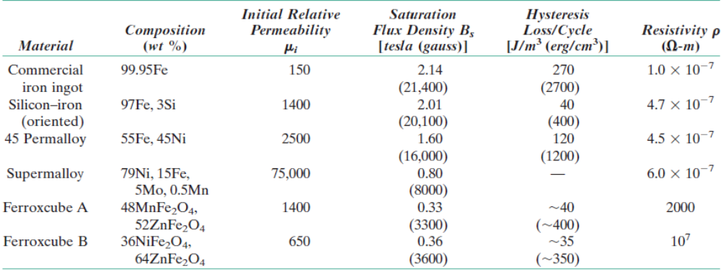
Soft and Hard Magnetic Materials
Properties of some soft magnetic materials

Slide 17
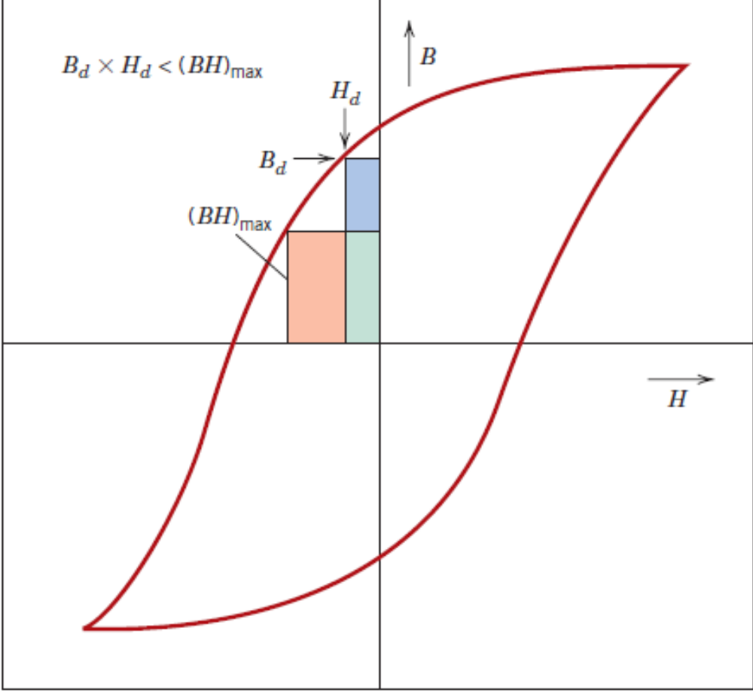
Soft and Hard Magnetic Materials
Hard magnetic materials are used in permanent magnets. They have high remanence, coercivity and saturation flux density.
Display significant resistance to demagnetization.
Characterized by a quantity called “Energy Product” denoted as (BH)_{max}.

Slide 18
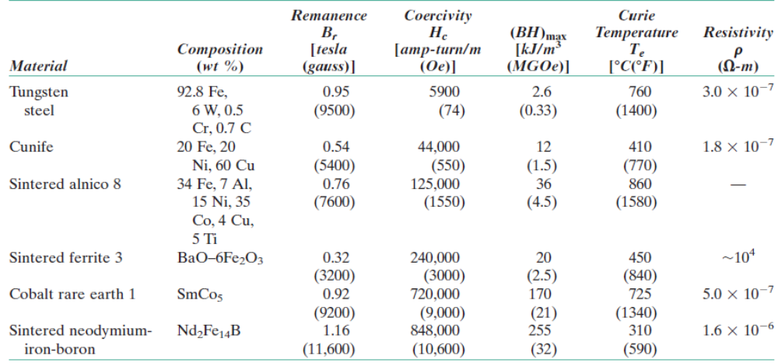
High Energy Hard Magnetic Materials
Properties of some hard magnetic materials

Slide 19
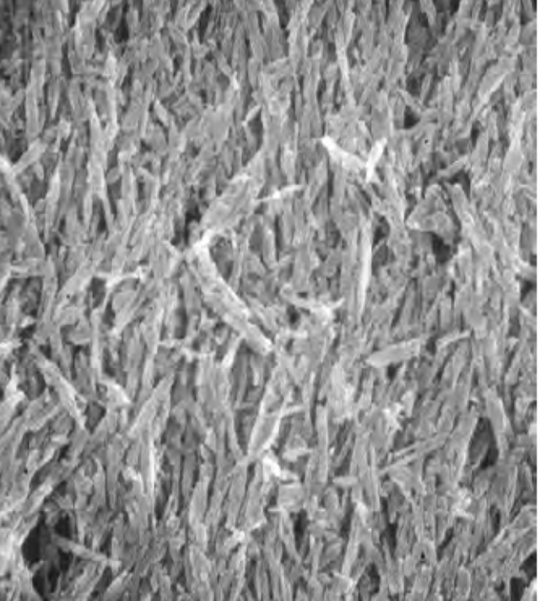
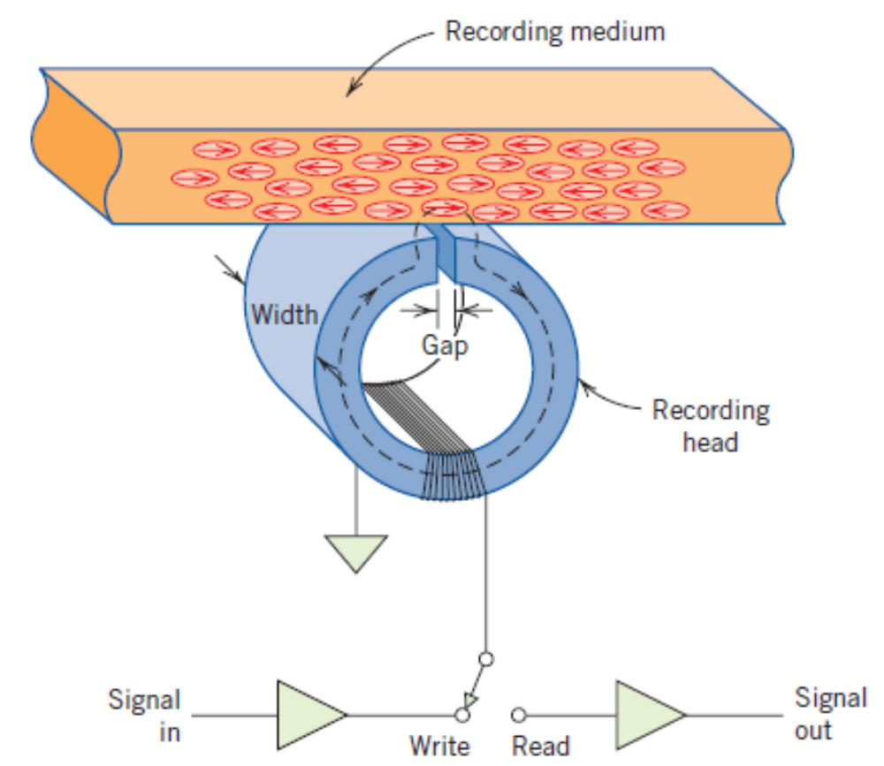
Magnetic Storage
γ Fe2O3 particles embedded within epoxy phenolin resin

Slide 20
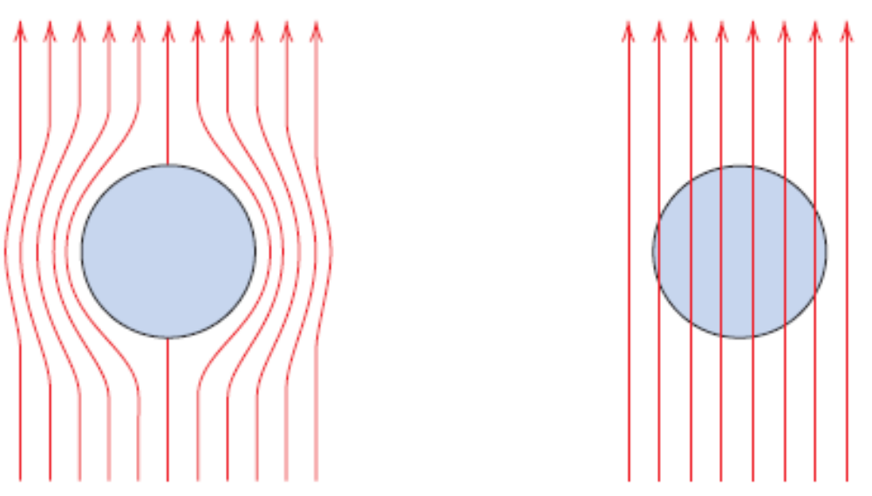
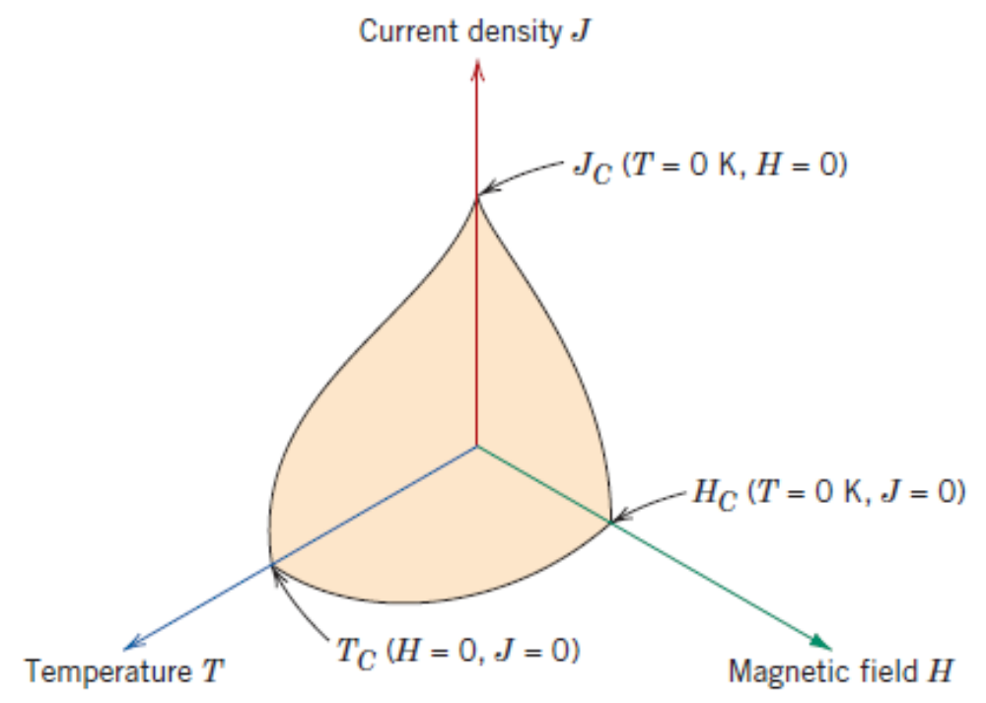
Superconductivity
Superconducting state
Normal state
Meissner effect in Type I Superconductors

